Slide 1

PeerHire: A Peer to Peer college based Freelancing Network
Summer internship submitted to
Indian Institute of Technology Kharagpur for the degree of Bachelor of Technology
in
Civil Engineering
by
Sumit Nirmal
20CE10075
DEPARTMENT OF CIVIL ENGINEERING
INDIAN INSTITUTE OF TECHNOLOGY
KHARAGPUR MAY 2023

Slide 2


Connecting the next generation of skilled freelancers

Slide 3
OUR MISSION
Revolutionizing freelancing for college students by fostering trust, community, and fair opportunities. Empowering students to showcase talents, gain work experience, and earn while studying.

Slide 4

PROBLEM
College students face challenges when it comes to earning money through freelancing:
Difficulty in getting the first client on popular freelancing websites.
Lack of trust and faith in freelancers.
High commission rates that eat into earnings.
Limited local networks for finding reliable clients.

Slide 5
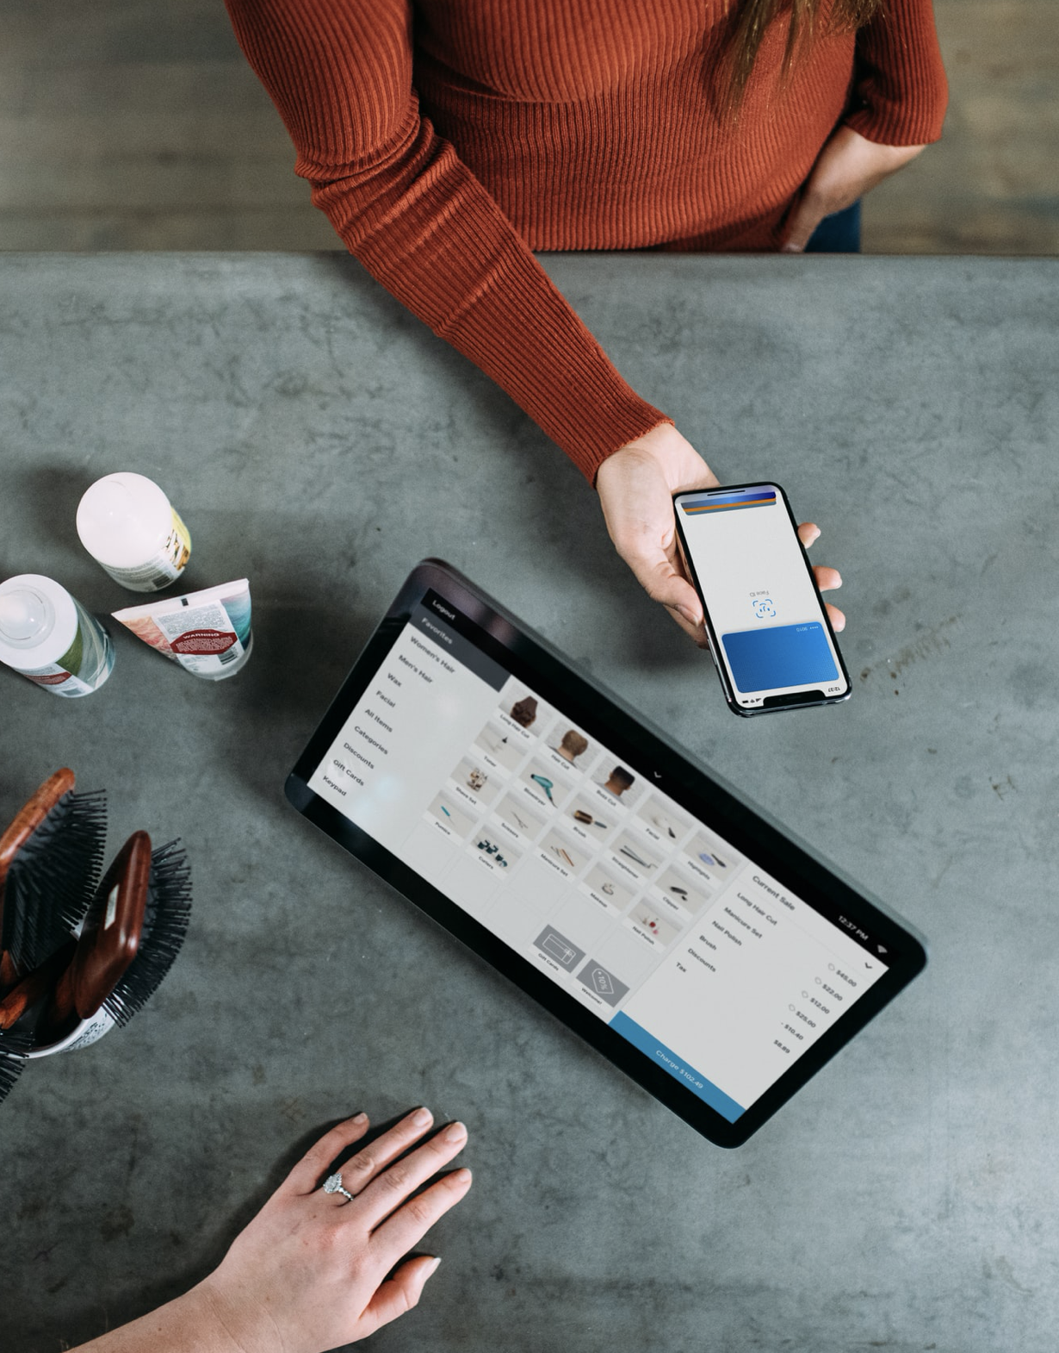
SOLUTION
Approach:
PeerHire introduces a comprehensive solution by establishing a dedicated peer-to-peer freelancing ecosystem exclusively for college students.
Service Offering:
Students with skills in web development, graphic design, content writing, tutoring, and more can list their services on the platform, creating a marketplace of diverse expertise.
Local Network:
The platform's localized approach addresses the trust issue by connecting students within the same college community, fostering familiarity and reliability.

Slide 6
JUSTIFICATION OF PAYMENT
Trust and Familiarity
Customers are willing to pay for PeerHire's solution because it offers a secure environment where freelancers and clients share a common college background. This familiarity mitigates concerns about hiring unknown freelancers.
Lower Commission Rates
PeerHire's unique selling point lies in its commission rates, charging only 5-10% of the total project cost. This competitive rate ensures that both service providers and clients retain a significant portion of their earnings, making the platform financially attractive.
Mutual Benefit
College students are motivated to pay for PeerHire's services as it not only provides access to reliable freelancers but also allows them to support fellow students by hiring their services. This reciprocal arrangement enhances the sense of community and justifies the cost.

Slide 7
MARKET POTENTIAL
College students represent a significant portion of the freelance market, offering diverse skills and cost-effective services.
The freelance market is growing rapidly, with an increasing number of businesses and individuals seeking freelancers for various services.
Market research indicates a strong demand for affordable, reliable, and community-focused freelance platforms like PeerHire.

Slide 8
Business model
PeerHire generates revenue through a commission fee of 5-10% on each project completed on the platform.
As the platform scales, additional monetization opportunities can be explored, such as premium features or targeted advertising.

Slide 9

PROJECTS AND TASKS
Development of PeerHire Website
Landing Page
Registration and Login
Dashboard
Project List and Creation
Bidding and Messaging
User Profiles and Managements Support, About and Policies
Social Media management and surveys
Establishing PeerHire’s Social Media Presence
Conducting Awareness Campaigns
Collecting User’s Feedback Through Survey

Slide 10
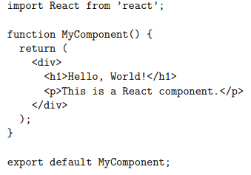
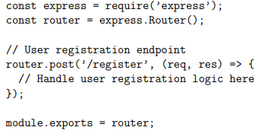
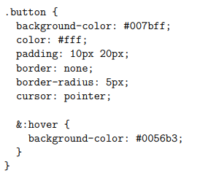
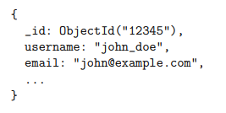
Full Stack Development Overview
Frontend Development:
Building User-Facing Components
Technologies: React.js and SCSS
Interactive Web Pages and Components
Backend Development:
Server-Side Components and Logic
Technologies: Node.js and Express.js
Creation of RESTful APIs
Data Base Management:
Efficient Data Storage and Retrieval
Utilized MongoDB
User Profiles, Projects, and Data Management

Slide 11
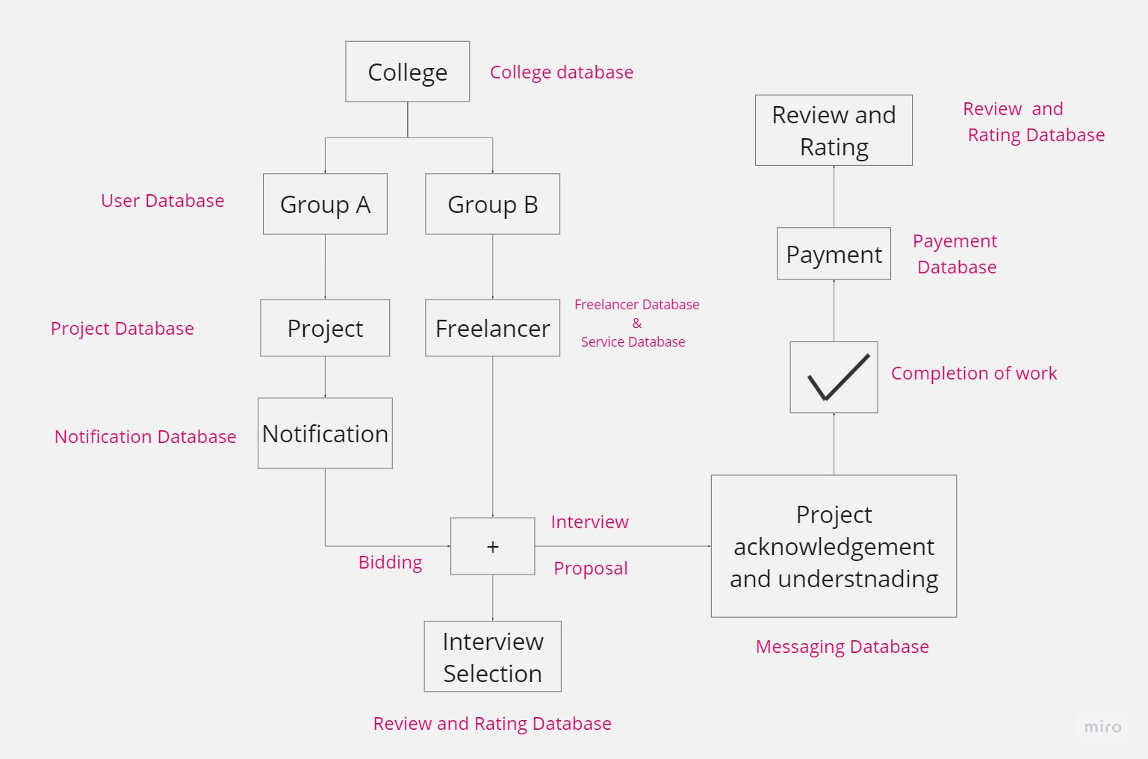
Flow Chart

Slide 12

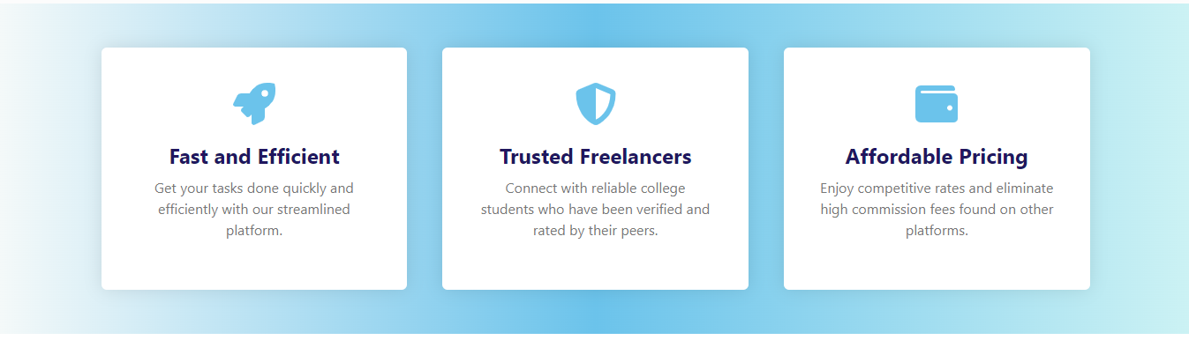
Landing Page

Slide 13
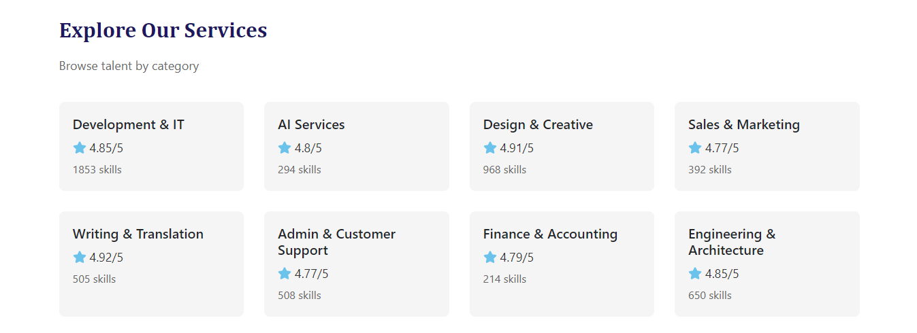

Landing Page

Slide 14
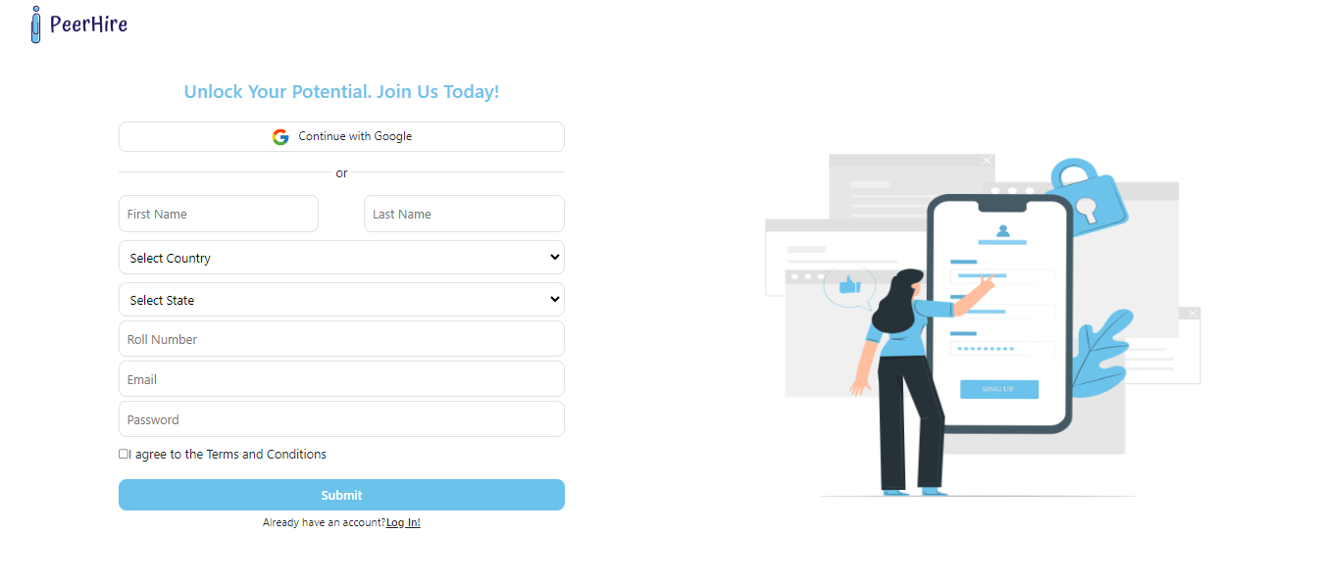
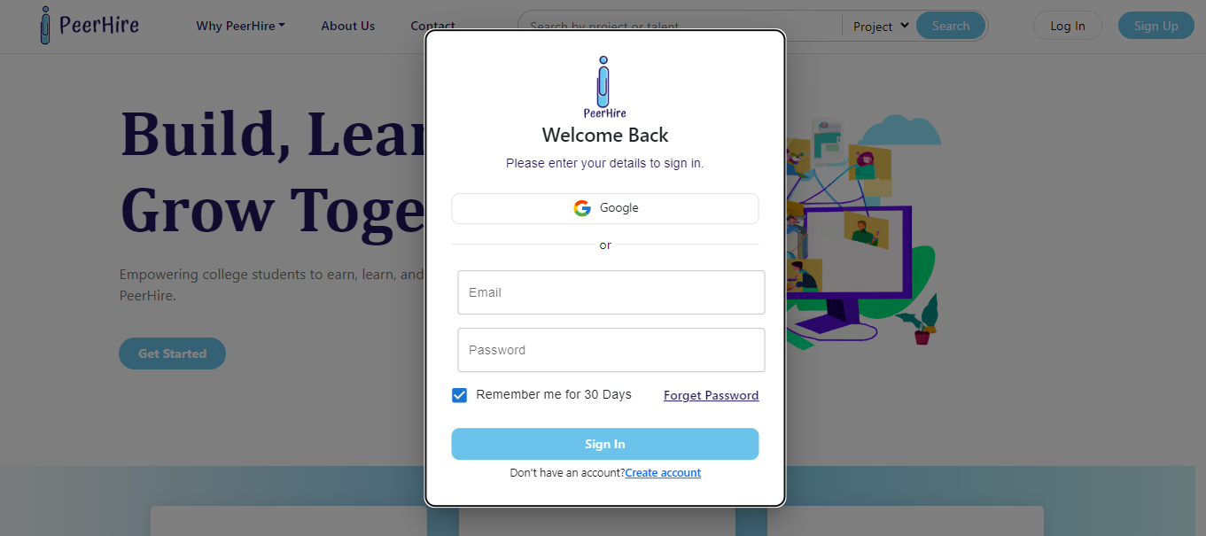
Registration and Login
Sign Up
Log in

Slide 15
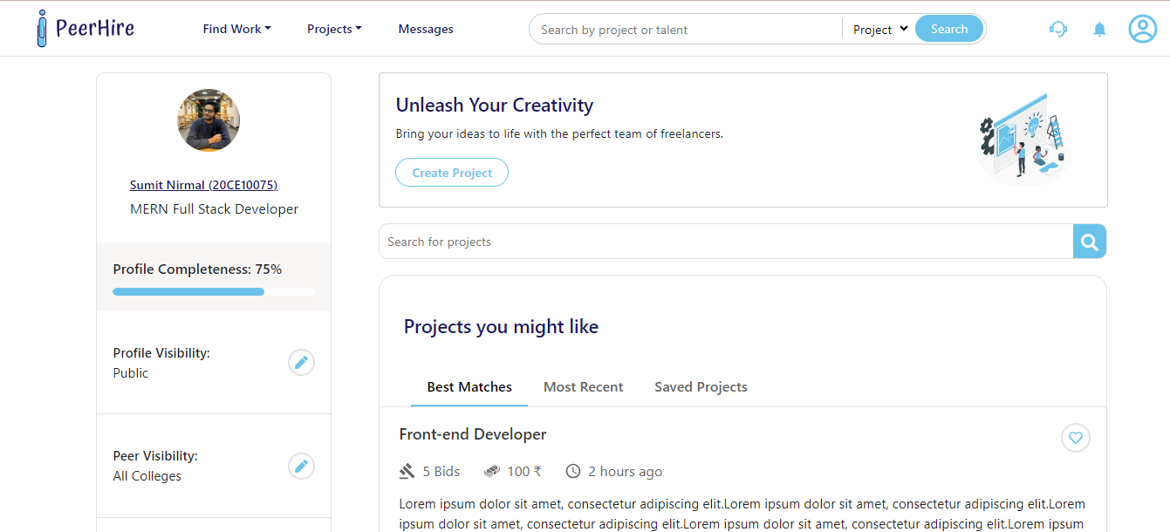
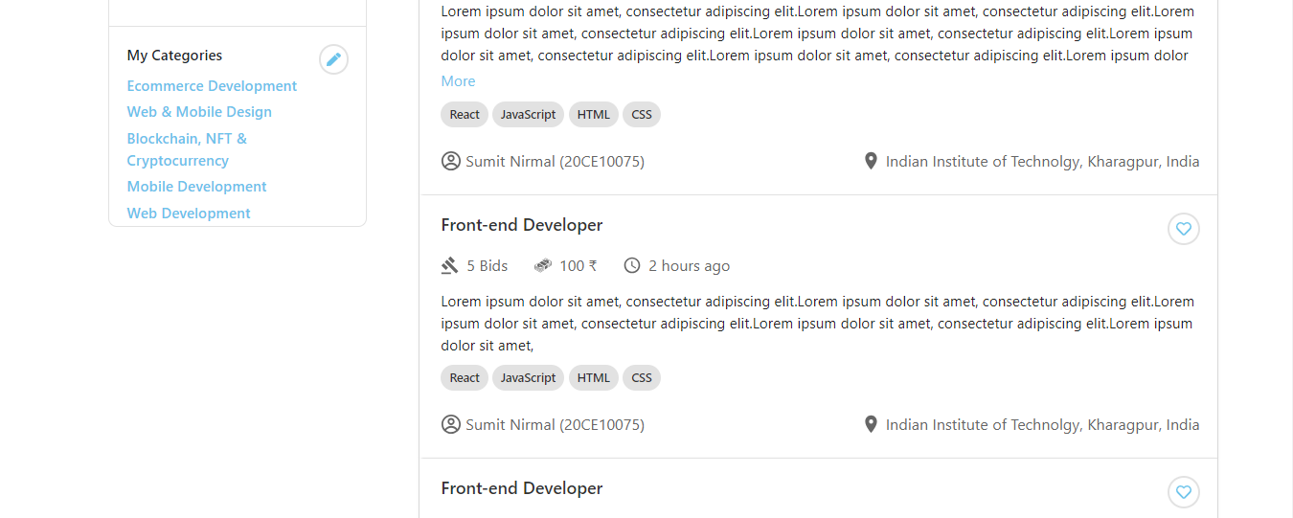
Dashboard
Here you can search project by inputting any keywords, you can also select categories, project type and budget range.
This is the page where you can see project submitted by the clients, here you

Slide 16
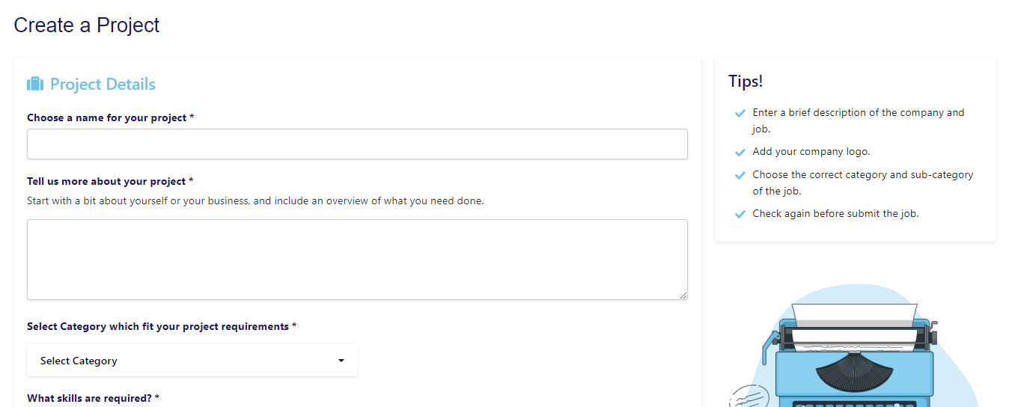
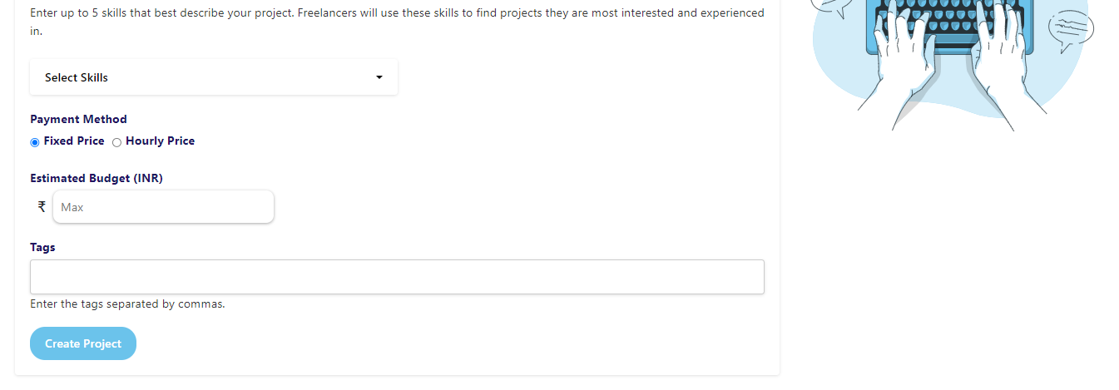
Project List and Creation
Here you can create your project by giving only name, description, category, skills needed, project type and tags

Slide 17
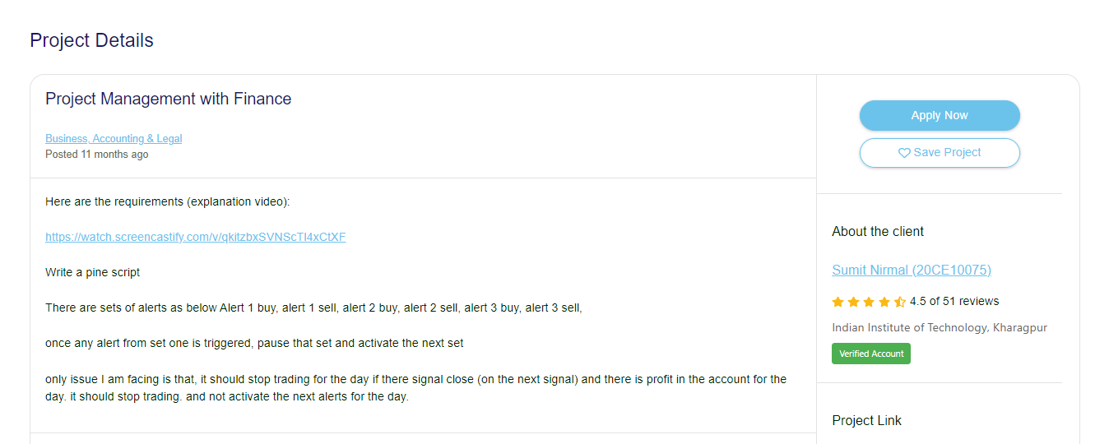
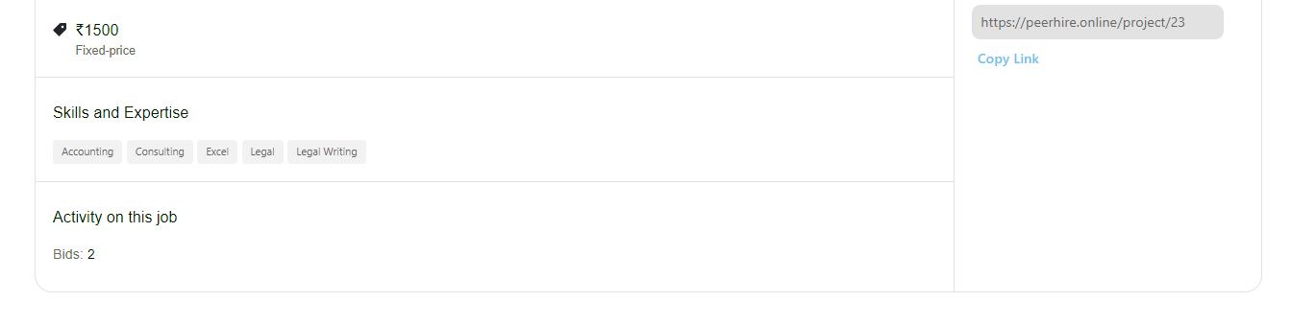
Project Details
You can see here the details of any project and also save and share link of the Project

Slide 18
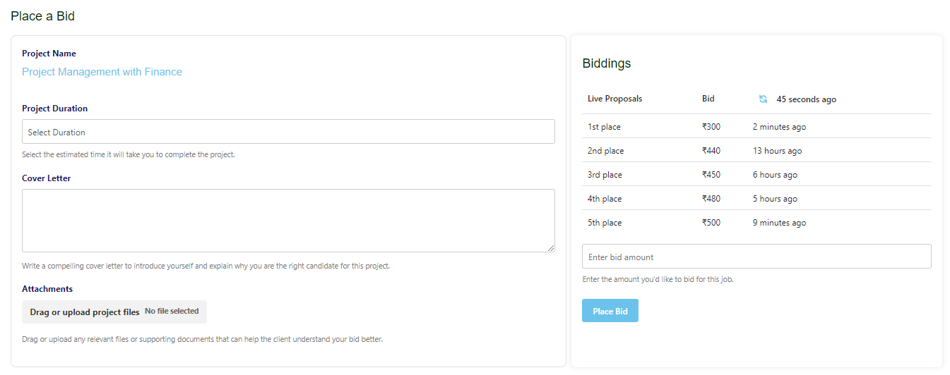
Proposal and Bidding
Here you can submit proposal and set you bid with your duration and cover letter

Slide 19
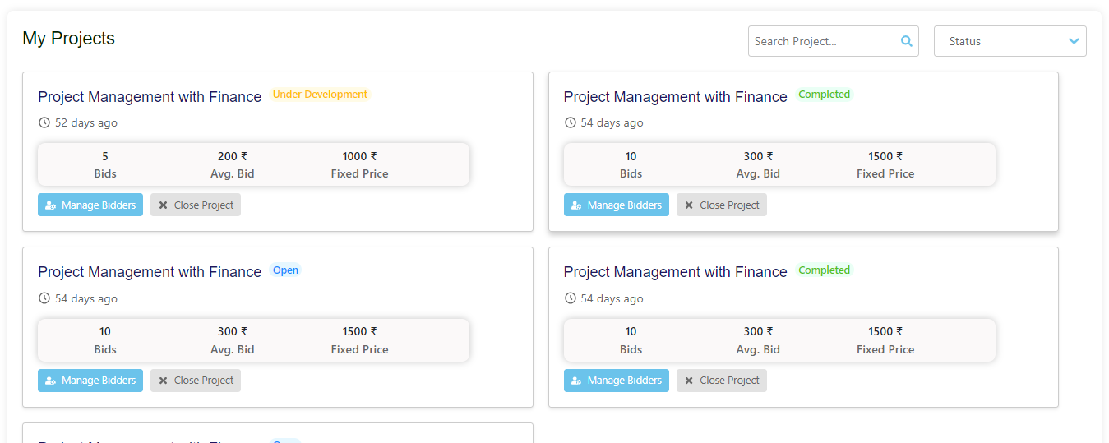
My Projects

Slide 20
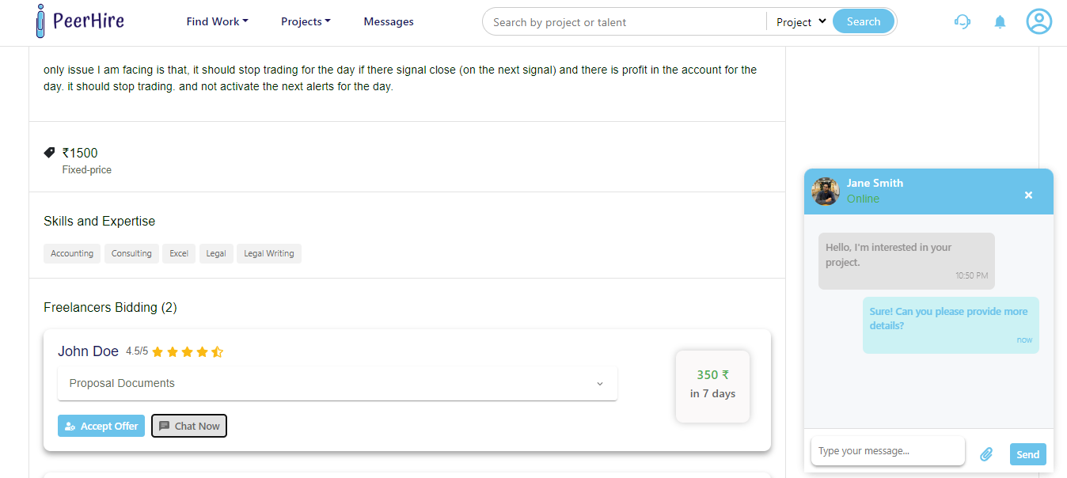
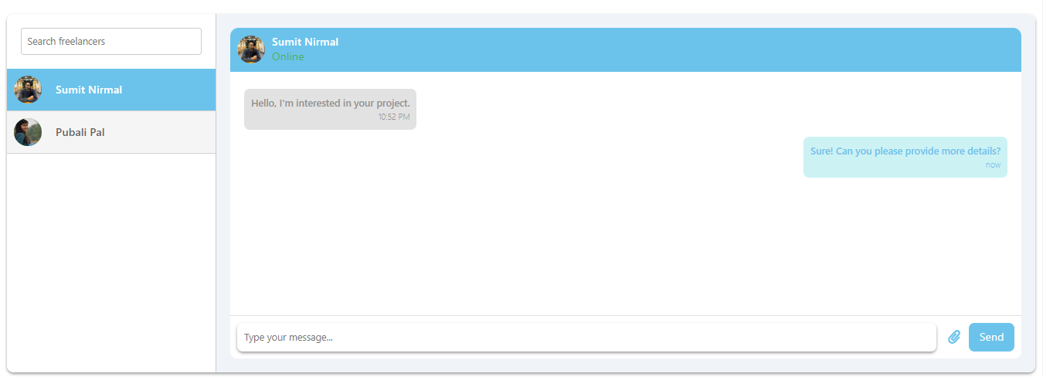
Messaging and Chat panel
These are the screen of Chat panel and message box, from here a client can chat with any freelancer and also can send the attachments

Slide 21
Achievements And Contributions
1
Skill Gained
Mastery of Full Stack Development Technologies
Enhanced Problem Solving Abilities
Improved Team Collaboration and Communication
2
Impact on Organization
Development of a Dynamic and Functional Freelancing Platform
Positive User Feedback and High User Engagement
Valuable Insights for Future Platform Enhancements
Increased Awareness and Visibility of PeerHire in the Academic Community

Slide 22

PeerHire
Thank you

